Slide 1


Analysis of Content Categories

Slide 2


Today's agenda
Project recap
Problem
The Analytics team
Process
Insights
Summary

Slide 3

The Project is Assigned by Social Buzz ( Social media and content creation Company) who wants Accenture to work on the following tasks -:
An audit of their big data Practice.
Recommendations for a successful IPO.
Analysing the content categories which should highlight the top 5 categories with largest aggregate Popularity.
Project Recap

Slide 4

Problem
A Big data involving details of 100000+ Posts per day.
How to use such a large data efficiently
Data Cleaning
Analysing the Top 5 Categories with the largest Aggregate Popularity

Slide 5



Andrew Fleming (Chief Technical Architect)
The Analytics team
Marcus Rompton
(Senior Principle)
Suraj Prasad
(Data Analyst)

Slide 6
Process
1
Understanding the data ( Consider the required Tables )
2
Cleaning the data ( Remove the unwanted Data)
3
Modelling the data ( Manage the data before analysis)
4
Analysing the data ( Approach for the required problem)
5
Solution (Providing the solution along with the insights)

Slide 7
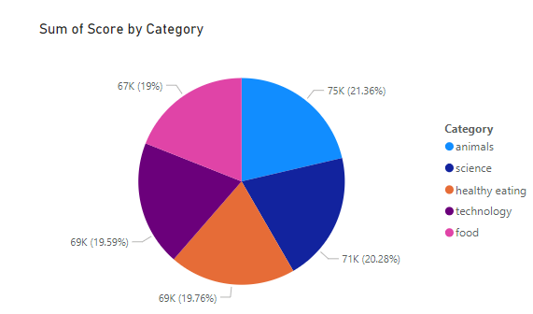

Insights

Slide 8
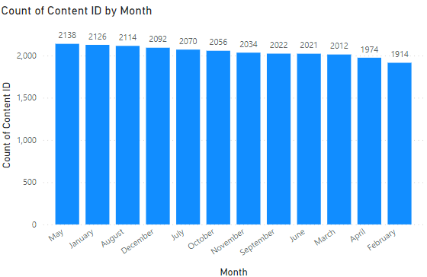

Slide 9
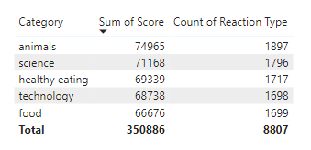
Number of Reactions to the most popular categories

Slide 10

The Project Involves three tables “Reaction”, “Content”, “Reaction Type”. The tables have been joined on the basis of specified column relationship “Reaction.id = Content.id” and “Reaction.Reactiontype = Reaction_types.type” . According to the analysis it was found that Animal , science, healthy eating , technology and food were the top 5 most popular categories.
Summary

Slide 11
Thank you!
ANY QUESTIONS?

